Slide 1
Formal qualifications versus non-cognitive skills in lower-skilled labor market segment: analyzing online job ads in Slovakia
Lucia Kurekova (SGI) (kurekova@governance.sk)
Miroslav Beblavy (CEPS)
Corina Haita (CEU)
Bratislava Economic Meeting, June 8-9, 2012

Slide 2
Background
NEUJOBS project (www.neujobs.eu/): studies link between the socio-ecological transition and labor market changes
Focus on low-skilled labor market segment
Initially - cross-country focus in this paper, but was not feasible due to unsuitability of data

Slide 3
Aims and focus
Understanding labor market demand at the micro-level (relative lack of research)
What types of skills are in demand among low-skilled workers?
RQ1: What types of skills are demanded in the low- and medium skilled occupations?
RQ2: How does the demand for skills (formal qualifications, cognitive, non-cognitive, experience) differ across different sectors and occupation groups?
Contributions:
Online job advertisements – systematic, comparable, large pool of data
PROFESIA data (www.profesia.sk)
Focus on Slovakia

Slide 4
Literature
Debate on the importance of formal qualifications in the labor market
Merit versus social background (increased merit selection hypotheses)
Overlooks other components of skills
Outdated, not directly applicable to relatively equalized post-socialized countries
Debate on the relative importance of non-cognitive and other non-meritocratic skills
Related to the growth of service sector – interactive service work
Likely to differ depending on the institutional background – especially education and skill formation system
Approached through the analysis of job advertisements
Source of information about skills that employers seek
Content analysis

Slide 5
Data
Private job portal (www.profesia.sk)
Major job portal with long data collection history
Collects demand (job ads) and supply data (CVs)
2011: 135 000 distinct job ads/vacancies & nearly 100 000 CVs
Job ads as well as applicants situated in the medium and low-skilled segment
Custom-made request
Selected occupations – decided to represent a variety of occupations
2007-2011 – after cleaning, over 50 000 job ads with specified content
Data is structured and very rich
Mandatory fields: education level requested, job description, location, occupation, some skills (computer, languages) also selected
Additional information: who posts the ad (firm or agency) and in which language

Slide 6
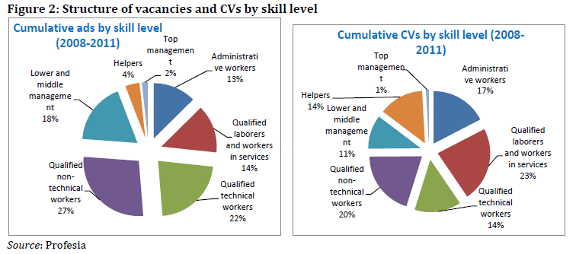

Slide 7
Skills and occupations
Categorization of skills
Formal education
Cognitive skills: general and specific
Non-cognitive skills: social and personal qualities
Appearance
Experience
Selection of occupations
Different sectors
Service occupations
Industry occupations
‘New’ occupations
Different ISCO 88 skill levels

Slide 8
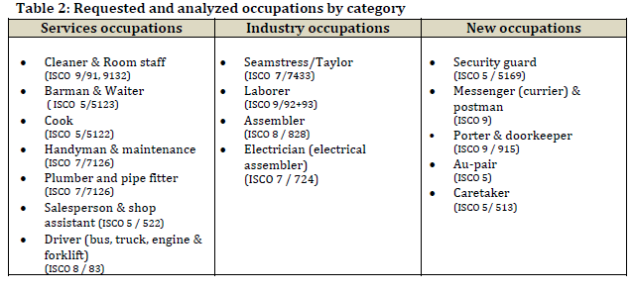
Occupations

Slide 9
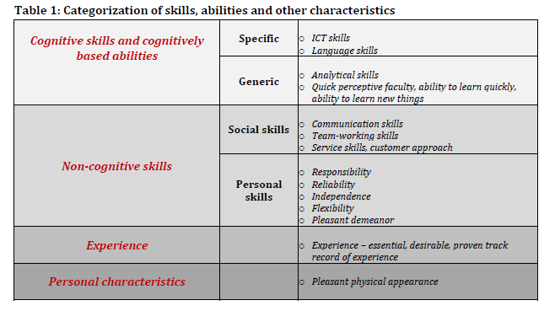
Categorization of skills

Slide 10
Key findings I
Ideal low and medium-skilled worker needs to demonstrate considerable set of skills and qualities
Only in two occupations was only primary level education requested in the majority of ads (ISCED 0-2)
Majority of occupations – requested secondary education without or with leaving examination (ISCED 3-4)
Non-cognitive skills and cognitive specific skills were more demanded than cognitive general and appearance across all occupations
Among social skills – communication skills
Among personal abilities/qualities – responsibility and flexibility
Even among low-skilled occupations, relatively large share of ads desired knowledge of foreign language
Experience was the single most requested factor

Slide 11
Key findings II
Large variation exists between the analyzed occupations
In the interactive service occupations – salesmen, waiters, barmen – employers expected higher skill intensity and variety than in remaining occupations
Previous experience was requested especially when filling occupations which require specific skills (are vocations) or certification – drivers, plumber, electrician, cook, tailor
Minimum education requirement did not correspond well to ISCO mapping – unskilled occupations required secondary education
Differences exists in relatively similar occupations (postman vs. currier)
Employers’ expectations with respect to minimum education requirements were more varied in the new occupations

Slide 12
Conclusions and implications
General implications
Online job ads data could be used as a rich source of data about micro-characteristics of labor market demand
Informing demand-led approach to labor market policy - what types of skills could be ‘given’ to persons with disadvantaged position in the labor market
Similar analysis could help identify the “least” and the “most” demanding occupations
If conducted over time, could help to track what skills are on the rise or in decline
New approach to analyzing elements of recruitment process and labor matching
Findings are informative for the Slovak education and skill formation system (changes to existing curricula or preparation of new ones)

Slide 13
Next steps
Cross-country analysis
EURES
Testing institutional context
Extending Slovak case in time (2004-2011) – boost and bust
Analysis of all skill levels – including high-skilled occupations
Including more skills – e.g. technical skills

Slide 14
Thank you.
Comments welcome at: kurekova@governance.sk

Slide 15
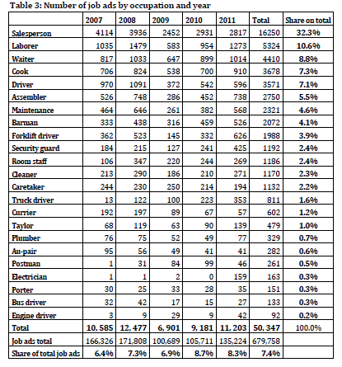

Slide 16
